Slide 1
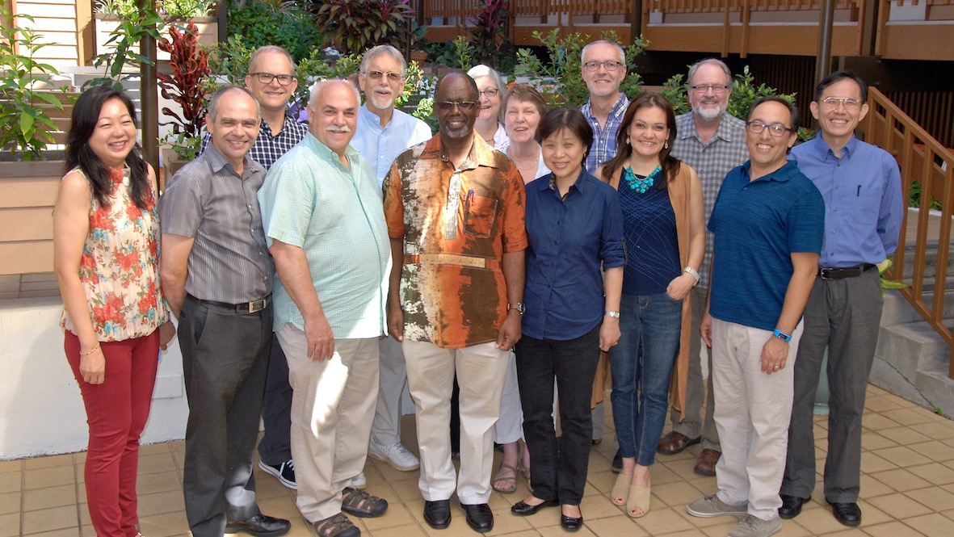
Cultural Intelligence
Kirk J. Franklin, PhD

Slide 2
Culture
The culture in which we grow up has a profound impact on how we see the world
In any given culture, members are conditioned to understand the world in a particular way, to see certain communication patterns as effective or undesirable, find certain arguments persuasive or lacking merit, to consider certain ways of making decisions or measuring time “natural” or “strange”
Erin Meyer, The Culture Map (New York: Public Affairs, 2014), 252.

Slide 3
Defining Culture
From the Latin cultūra, meaning ‘cultivation, agriculture, tillage, care,’ or the tilling of the soil. Culture is, therefore ‘a collection of behaviours and beliefs associated with a particular group’ (Dictionary.com)
A person’s ‘mental software’ because culture functions as our software for our behaviour of ‘thinking, feeling, and acting’ (G Hofstede, G J Hofstede, & Michael Minkov)

Slide 4
Defining Culture
‘Culture is often a way that ethnicities, religions, races, and various social and personal factors are lumped together to describe someone’s background’ (dictionary.com)
It is a collective communal experienced learned and shared through unwritten rules amongst people within the same social environment (G Hofstede, G J Hofstede, & Michael Minkov)

Slide 5
The Cultural Iceberg
10% visible at any given time
90% hidden beneath the surface
Edward T. Hall (1976); image DALL-E3

Slide 6
Surface Culture
Everything above the water; What is visible
= Food, dress code, and language, etc.
Deep Culture
Everything below the water; What is not visible at first inspection
= Cultural values, beliefs, traditions, and ‘the way we do things around here’

Slide 7
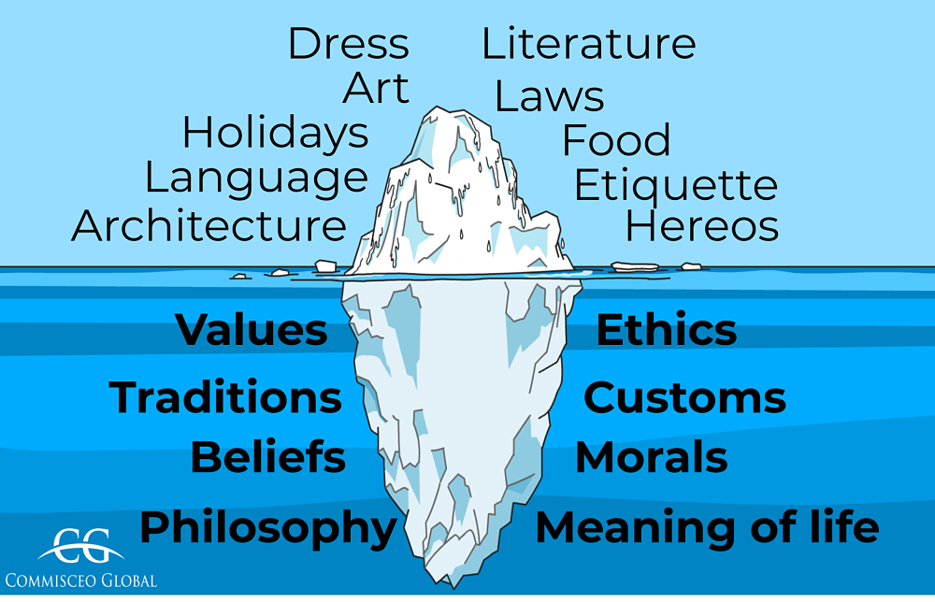
Source: https://www.commisceo-global.com/blog/intercultural-training-and-the-iceberg-model

Slide 8
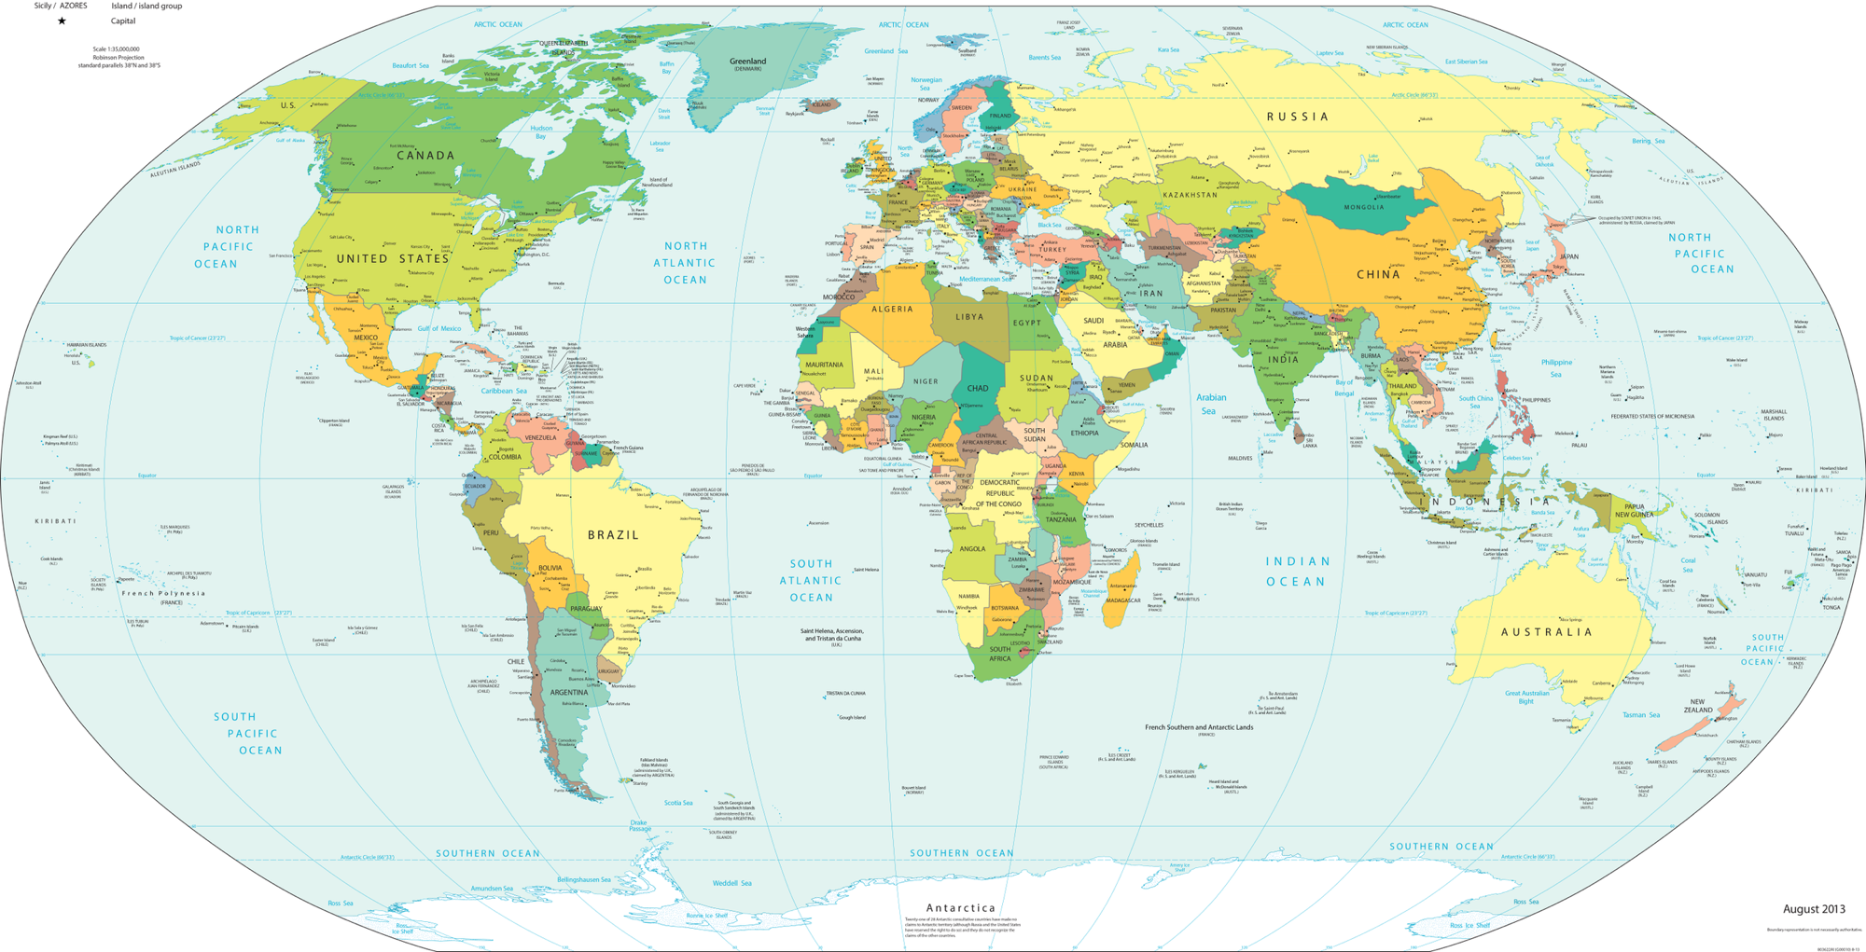
Influence from Cultural Environment Upon Intelligence
pursue learning and lifelong learning
responsible participation in family and social life
benevolent, humble, does what is right
intellectual self-assertion and self-effacement
practical problem solving, verbal ability, and social competence
noticing, recognizing, understanding, comprehending
social responsibilities, cooperation, obedience
pragmatic, adaptable, straightforward communication, collaborative

Slide 9
Cultural Intelligence (CQ)
Ability to successfully adapt to unfamiliar cultural settings
- Mai Moua
A form of intelligence that can be developed and learned by anyone
- David Livermore
Develop skills to:
- understand
- learn from
- adapt to a culture
Through:
- interactions
- fostering empathy
- appropriate behaviours
Cultural contexts can be diverse: different national, ethnic, organizational, and generational. We function and adapt to multiple cultural environments

Slide 10
Developing CQ
learning another language
cross-cultural work experience
living in diverse cultural settings
studying abroad
taking short trips to other cultures
interaction with unfamiliar cultures
openness to new intercultural situations and experiences
learning about how people of other cultures think, behave and believe
________________

Slide 11
Cultural Differences that Confuse
Duane Elmer, Cross-Cultural Connections: Stepping out and Fitting in around the World (Downers Grove, IL: InterVarsity Press, 2002).
Time and Event
event-oriented <…………………………………> time conscious oriented
polychronic (flexible, less structured, relationships over schedules, interruptions are OK)
monochronic (time is linear, segmented, structured, scheduled, punctual, deadlines, interruptions are disruptive)
Show understanding and flexibility, and focus on the significance of events
Be organized and punctual, and ensure that schedules and deadlines are respected

Slide 12
Cultural Differences that Confuse
Task and Relationship
goal driven <……………….………………………> nurturing relationships
Be clear, concise, and organized; focus on meeting deadlines and achieving results; respect their need for efficiency and direct communication
Invest time in building trust and personal connections; allow for flexible schedules and an indirect approach to communication; show respect for their relationships and social norms

Slide 13
Cultural Differences that Confuse
Individualism and Collectivism
independent <………………………………………………> part of a group
Recognize and respect individual autonomy and personal responsibility; be aware that people may prioritize their own interests when making decisions
Be mindful of how your actions affect the group and strive to build strong, trusting relationships; understand that decisions may involve consulting or seeking approval from group members

Slide 14
Cultural Differences that Confuse
Categorical and Holistic Thinking
two-dimensional <…………….……………………………> part of a whole
Provide clear, organized information with well-defined categories; use logical, step-by-step explanations and be precise in your communication
Present information in a way that highlights the broader context and interrelationships; be open to discussing how different factors influence each other and consider the overall system when making decisions

Slide 15
Cultural Differences that Confuse
Linear or Curved Logic
linear and direct <……………..…………………………> spiral and indirect
Be clear, organized, and direct in communication; present information in a structured, logical manner and focus on delivering a straightforward argument or solution
Have a more nuanced, context-driven discussion; appreciate importance of relationships and the broader context; be flexible in problem-solving and decision-making

Slide 16
Cultural Differences that Confuse
Achieved or Ascribed Status
status is through diligence <…….………………………> status is ascribed
Recognize and value individual accomplishments and contributions; evaluate people based on their skills and performance; encourage personal development and merit-based recognition
Respect traditional roles and hierarchical structures; appreciate the importance of inherited status and social background in shaping individuals' roles and expectations

Slide 17
Cultural Differences that Confuse
Guilt or Shame
avoiding wrongdoing <…………………….……………> upholding honour
Address specific behaviours and actions; encourage self-reflection and personal responsibility; provide opportunities for individuals to make amends and demonstrate change
Be sensitive to actions or comments that lead to feelings of shame or humiliation; recognize importance of social standing and family honour in shaping individuals’ responses and behaviours

Slide 18
High or Low Context
Erin Meyer: Low Context vs. High Context Societies
low <---------------------------------------------------------------------------------> high
Low-level of shared context; explicit communication, simple and clear
High-level of shared context; implicit communication, layered or nuanced
Be clear, direct, and explicit in your communication; provide detailed information and avoid assuming that your message will be understood without further explanation
Pay attention to non-verbal cues, tone of voice, and the broader context of the communication; avoid being overly direct or confrontational

Slide 19
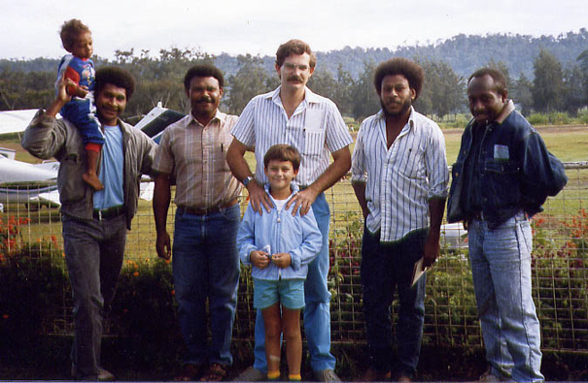
Third Culture Kids (Adults)
Third Culture Kids (TCKs)
First Culture:
Parent’s culture
Second Culture:
Host culture
Third Culture:
Living in-between

Slide 20
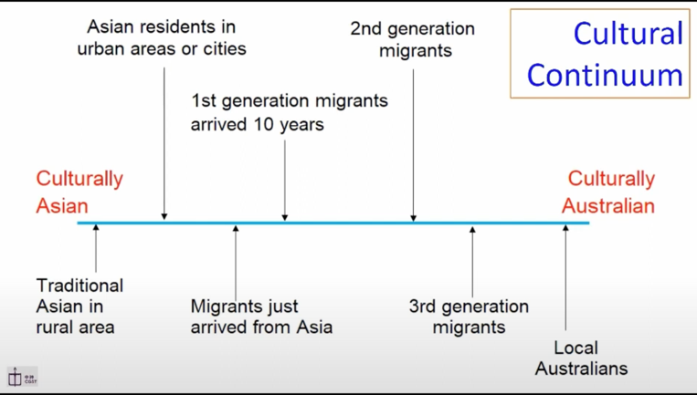
Cultural Continuum
Source: Rev Dr Michael Chu

Slide 21
GLOBE Universals
Global Leadership and Organizational Behavior Effectiveness
The GLOBE researchers examined leaders and followers across sixty-two countries to determine the leadership differences and universals across these diverse cultures. As a result, they identified nine universals

Slide 22
Global Leadership and Organizational Behavior Effectiveness (GLOBE)
Performance Orientation | extent to a reward for improved performance and excellence | Cooperative — Competitive
Assertiveness | extent to assertive versus submissive social relationships | Low context (direct) — High context (indirect)
Future Orientation | extent to engage in future-oriented activities such as planning, investing | Short term — Long term
Humane Orientation | extent to encouragement to be fair | Being (quality of life) — Doing (busy meeting goals)
Institutional Collectivism | extent to encouragement for institutional or societal action | Universalist (rules apply to all) — Particularist (standards are based on relationships)
In-Group Collectivism | extent to express pride, loyalty, and cohesiveness in organizations or families | Individualist (individual goals and rights) — Collectivist (group goals and personal relationships)
Gender Egalitarianism | degree to an organization/ society minimizing gender role differences | Differentiation (ambition and assertiveness) — Equality (sharing and nurturing)
Power Distance | amount of distance between leaders and followers | Hierarchy, high (authority, disparity) — Egalitarian, low (equality)
Uncertainty Avoidance | extent to relying on established social norms to avoid uncertainty | Certainty (stability) — Uncertainty (ambiguity)

Slide 23
Power Distance | The degree to which members of a group expect and agree that power should be shared unequally
 | High power distance [egalitarian, nonhierarchical] | Moderate | Low power distance [hierarchy, disparity]
 | Anglo, Germanic Europe and Nordic countries | Confucian Asian, Eastern Europe (variations), Latin Europe (variations), Sub-Saharan Africa | Arab nations, Latin America, Southern Asia (variations)

Slide 24
Uncertainty Avoidance | Extent to which a society, an organization, or group relies on established social norms, rituals, and procedures to avoid uncertainty
 | Low uncertainty avoidance [stability] | Moderate | High uncertainty avoidance [ambiguity]
 | Anglo, Germanic Europe and Nordic countries | Confucian Asian, Eastern Europe (variations), Latin Europe (variations), Sub-Saharan Africa | Arab nations, Latin America, Southern Asia (variations)

Slide 25
Performance Orientation | Extent to which a context encourages and rewards group members for improved performance and excellence—whether cultures are cooperative or competitive
 | Cooperative | Moderate | Competitive
 | Nordic countries, Sub-Saharan Africa | Confucian Asia, Eastern Europe, Latin America, Latin Europe, and Southern Asia (variations) | Anglo and Germanic Europe

Slide 26
Assertiveness | Extent to which a context is determined, assertive, confrontational, and aggressive in social relationships
 | Low context (direct) | Moderate | High context (indirect)
 | Anglo, Germanic Europe, Nordic countries | Eastern Europe, Latin America, and Latin Europe | Arab, Confucian Asia, Southern Asia (variations), Sub-Saharan Africa

Slide 27
Future Orientation | Extent to which people engage in future-oriented behaviors such as planning, investing in the future, and delaying gratification
 | Short term | Moderate | Long term
 | Anglo, Arab, Eastern Europe, Nordic countries and Sub-Saharan Africa | Germanic Europe, Latin America, Latin Europe and Southern Asia | Confucian Asia

Slide 28
Humane Orientation | Degree to which a culture encourages and rewards people for being fair, altruistic, generous, caring, and kind to others
 | Being | Moderate | Doing
 | Arab, Latin America, Nordic Europe, and Sub-Saharan Africa | Confucian Asia (variations), Eastern Europe, Latin Europe, and Southern Europe (variations) | Anglo and Germanic Europe

Slide 29
Institutional Collectivism | The degree to which organizational or society encourages institutional or societal action
 | Universalist [emphasis on rules, standards apply to everyone] | Moderate | Particularlist [emphasis on specifics, unique standards based on relationships]
 | Anglo, Germanic Europe and Nordic countries | Eastern Europe and Latin America | Arab nations, Confucian Asia (variations), Latin America, Southern Asia, Sub-Saharan Africa

Slide 30
In-Group Collectivism | The degree to which people express pride, loyalty, and cohesiveness in their organizations or families
 | Individualist [personal incentives] | Moderate | Collectivist [group goals]
 | Anglo, Germanic Europe and Nordic countries | Eastern Europe and Latin America | Arab nations, Confucian Asia (variations), Latin America, Southern Asia, Sub-Saharan Africa

Slide 31
Gender Egalitarianism | The degree to which an organization or society minimizes gender roles and differences and promotes gender equality
 | Equality | Moderate | Disparity
 | Anglo, Germanic Europe and Nordic countries | Singapore, Malaysia, Argentina, Hong Kong, Greece | India, Zambia, Morocco, Egypt, Kuwait, South Korea

